Slide 1
網路概論實習課L15

Slide 2
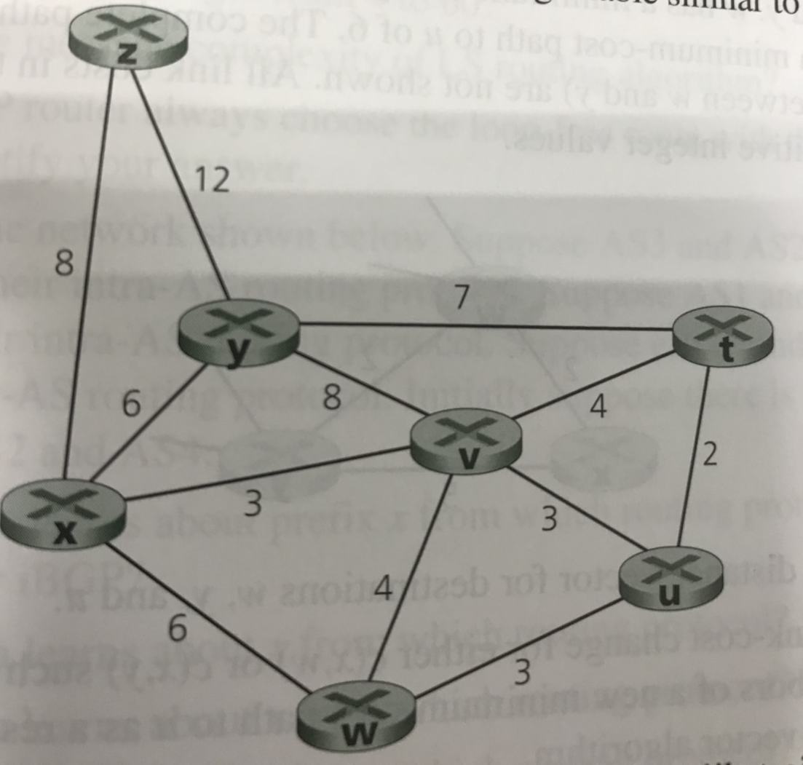
P4. Consider the following network . Using Dijkstra’s algorithm , and showing your work using a table similar to Table 5.1 do the following :
Compute the shortest path from t , u , v , w , x , y , z to all network nodes

Slide 3
Step N’ D(x),p(x) D(u),p(u) D(v),p(v) D(w),P(w) D(y),p(y) D(z),p(z)
0 t ∞ 2,t 4,t ∞ 7,t ∞
tu ∞ 4,t 5,u 7,t ∞
tuv 7,v 5,u 7,t ∞
tuvw 7,v 7,t ∞
tuvwx 7,t 15,x
tuvwxy 15,x
tuvwxyz

Slide 4
Step N’ D(x),p(x) D(t),p(t) D(v),p(v) D(w),P(w) D(y),p(y) D(z),p(z)
0 u ∞ 2,u 3,u 3,u ∞ ∞
ut ∞ 3,u 3,u 9,t ∞
utv 6,v 3,u 9,t ∞
utvw 6,v 9,t ∞
utvwx 9,t 14,x
utvwxy 14,x
6 utvwxyz

Slide 5
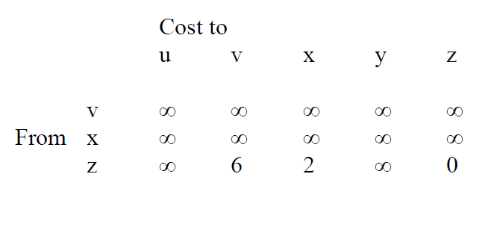
P5. Consider the network shown below , and assume that each node initially knows the costs to each of its neighbor . Consider the distance-vector algorithm and show the table entries at node z.
1
u
v
6
2
3
z
y
x
2
3

Slide 6
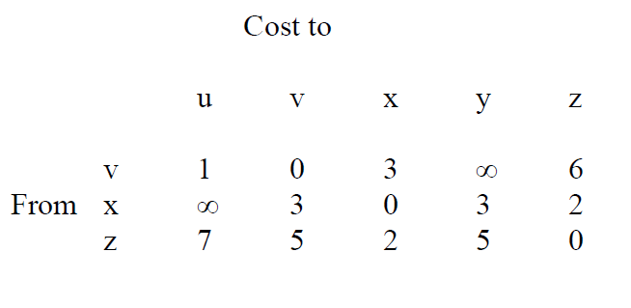
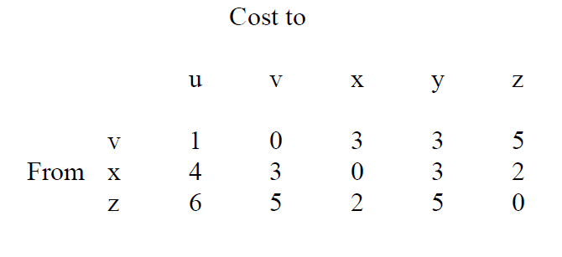
1
u
v
6
2
3
z
y
x
2
3

Slide 7
P8.Consider the three-node topology shown in Figure 5.6.Rather than having the link costs shown in Figure 5.6 , the link costs are c(x,y)=3,c(y,z)=6, c(z,x)=4 . Compute the distance tables after the initialization step and after each iteration of a synchronous version of the distance-vector algorithm.
x
4
3
z
y
6

Slide 8
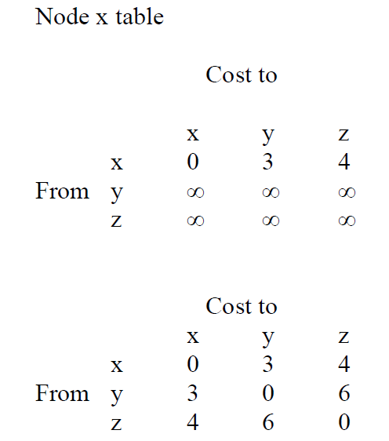
x
4
3
z
y
6

Slide 9
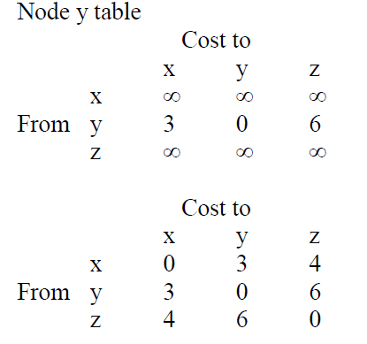
x
4
3
z
y
6

Slide 10
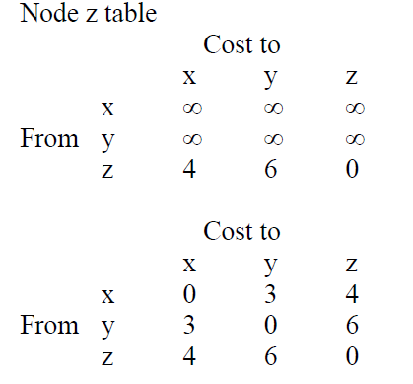
x
4
3
z
y
6

